Slide 1

Naïve Bayes Classifier

Slide 2
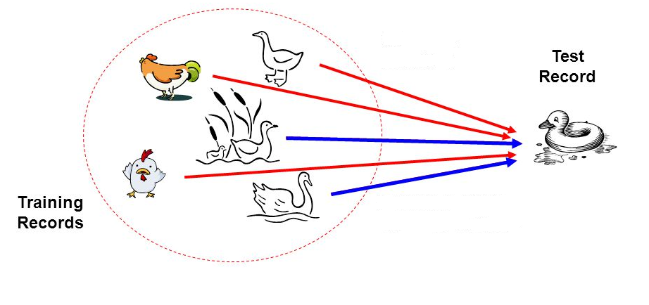
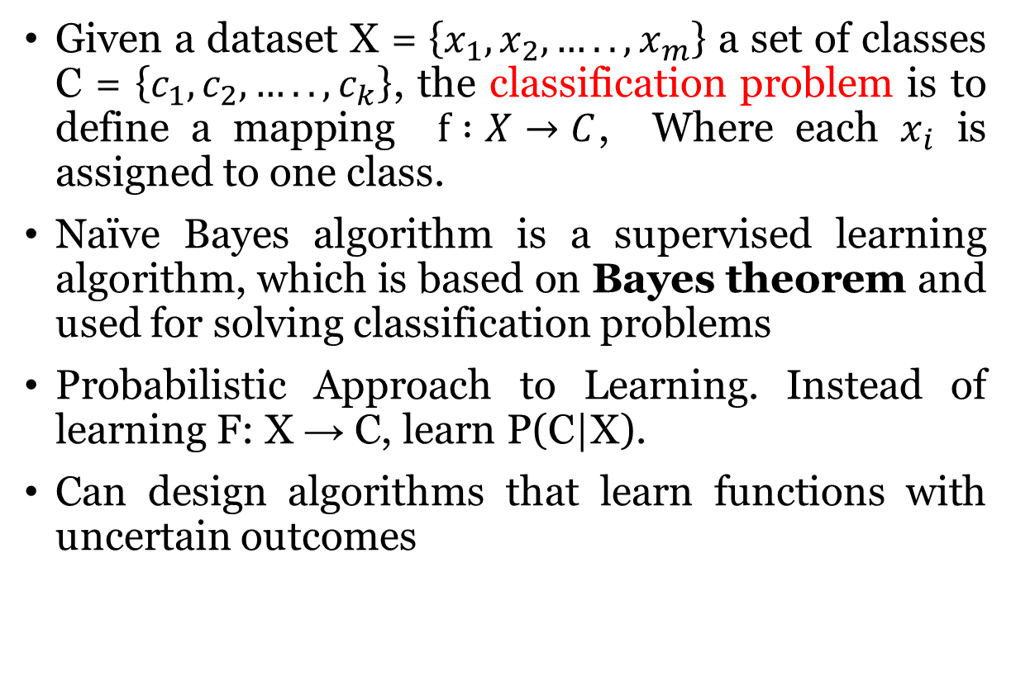
Naïve Bayes Classifier
Given a dataset X = $\left\{x_{1},x_{2},…..,x_{m}\right\}$ a set of classes C = $\left\{c_{1},c_{2},…..,c_{k}\right\}$, the classification problem is to define a mapping $f :X→C$, Where each $x_{i}$ is assigned to one class.
Naïve Bayes algorithm is a supervised learning algorithm, which is based on Bayes theorem and used for solving classification problems
Probabilistic Approach to Learning. Instead of learning F: X → C, learn P(C|X).
Can design algorithms that learn functions with uncertain outcomes

Slide 3
Applications
Face Recognition
Weather Prediction
Medical Diagnosis
News Classification

Slide 4
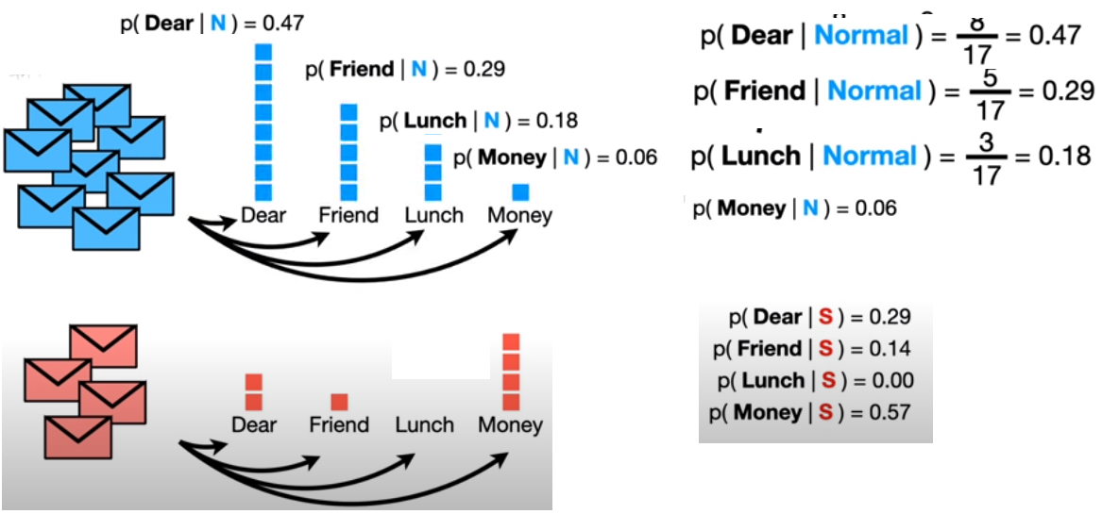
Example: Normal / Spam mail Classification
Slides taken from Josh Starmer, statquest

Slide 5
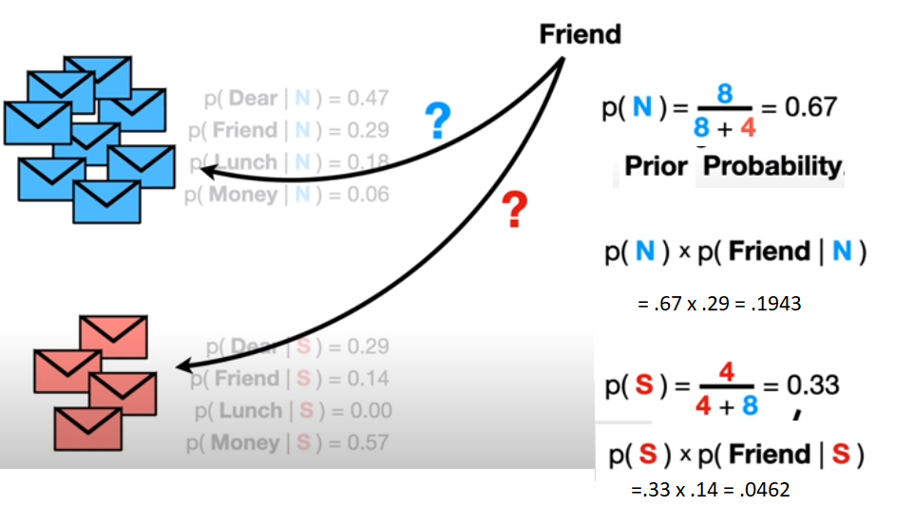
Example: Normal / Spam mail Classification
Slides taken from Josh Starmer, statquest

Slide 6
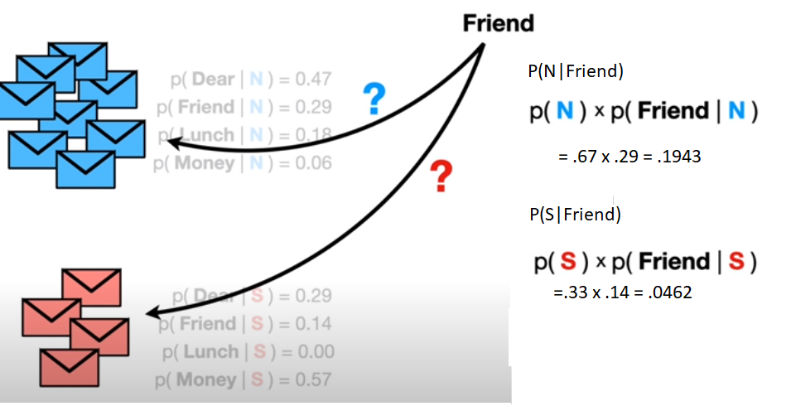
Example: Normal / Spam mail Classification
Slides taken from Josh Starmer, statquest

Slide 7
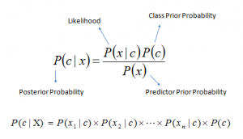
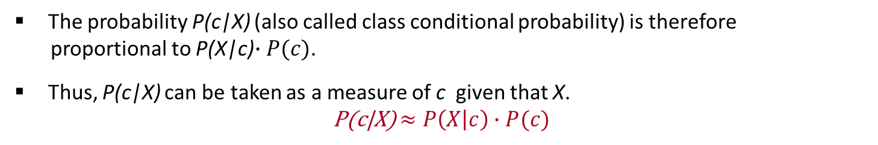

Naïve Bayesian Classifier
Suppose, c is a class variable and X = $\left\{X1,X_{2},…..,X_{n}\right\}$ is a set of attributes, with instance of c.
Naïve Bayesian classifier calculate this posterior probability using Bayes’ theorem
The probability P(c|X) (also called class conditional probability) is therefore
proportional to P(X|c)$∙P(c)$.
Thus, P(c|X) can be taken as a measure of c given that X.
P(c|X) $≈P\left(X | c\right)∙P(c)$

Slide 8
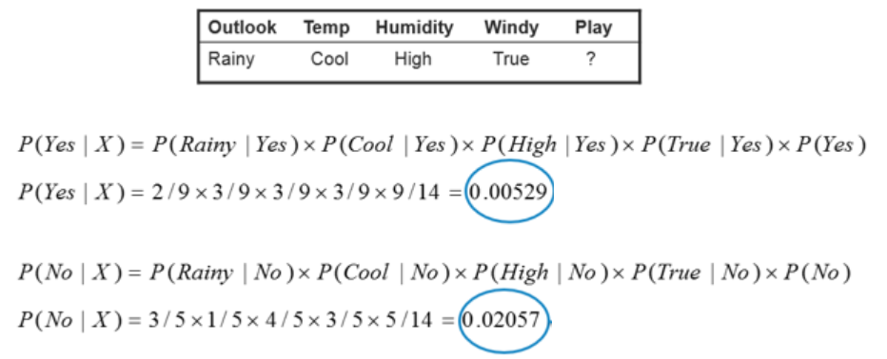
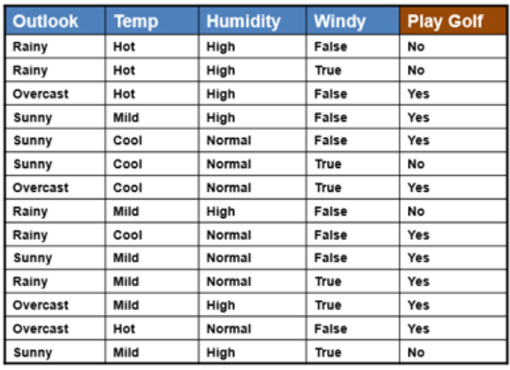
Weather data set
https://www.saedsayad.com/naive_bayesian.htm

Slide 9
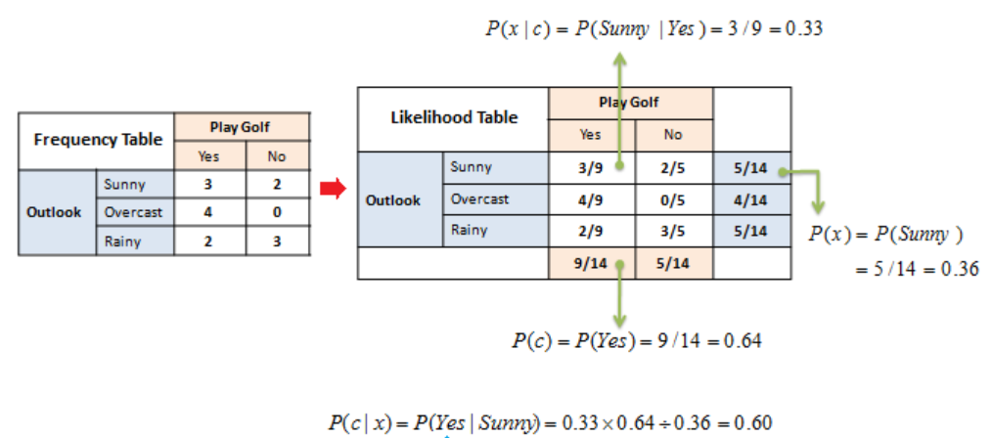
Likelihood Table

Slide 10
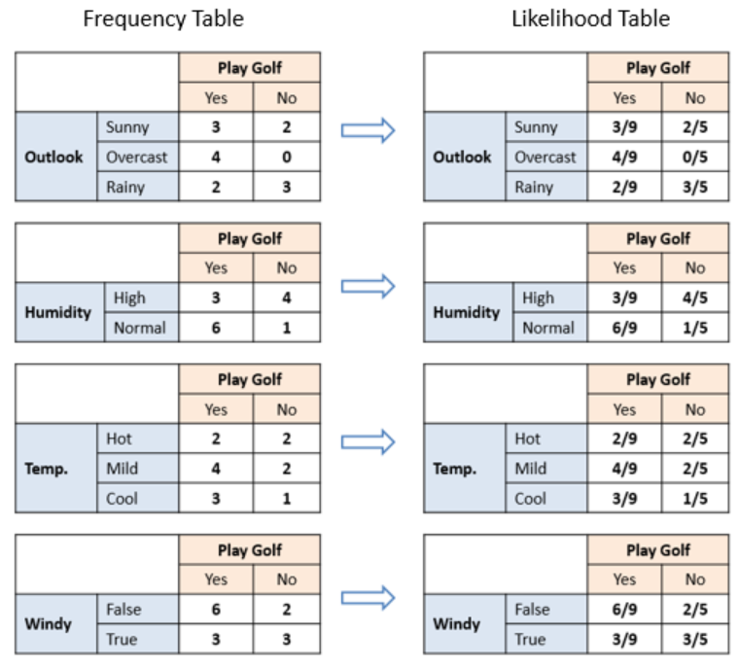

Slide 11
Prediction on test data

Slide 12

Naïve Bayesian Classifier Algorithm
Input: Given a set of k mutually exclusive and exhaustive classes C = $\left\{c_{1},c_{2},…..,c_{k}\right\}$, which have prior probabilities P(C₁), P(C₂),….. P(C_{k}).
There are n-attribute set A = $\left\{A_{1},A_{2},…..,A_{n}\right\},$ which for a given instance have values $A_{1}$ = $a_{1}$, $A_{2}$ = $a_{2}$,….., $A_{n}$ = $a_{n}$
Step: For each $c_{i} ∈C$, calculate the class condition probabilities, i = 1,2,…..,k
$p_{i}=P\left(C_{i}\right)\text{×}\prod_{j=1}^{n}{P(A_{j}= a_{j}|C_{i}})$
$$p_{x}=\max\left\{p_{1},p_{2},…..,p_{k}\right\}$$
Output: $C_{x}$ is the classification

Slide 13
Naïve Bayesian Classifier Pros and Cons
Pros
simple and easy to implement
doesn’t require as much training data
handles both continuous and discrete data
fast and can be used to make real-time predictions
not sensitive to irrelevant features
Cons
assumption of independent predictors
zero frequency problem

Slide 14
Example
No. | Swim | Fly | Crawl | Class Label
1 | Fast | No | No | Fish
2 | Fast | No | Yes | Animal
3 | Slow | No | No | Animal
4 | Fast | No | No | Animal
5 | No | Short | No | Bird
6 | No | Short | No | Bird
7 | No | Rarely | No | Animal
8 | Slow | No | Yes | Animal
9 | Slow | No | No | Fish
10 | Slow | No | Yes | Fish
11 | No | Long | No | Bird
12 | Fast | No | No | Bird
13 | Slow | Rarely | No | ?

Slide 15
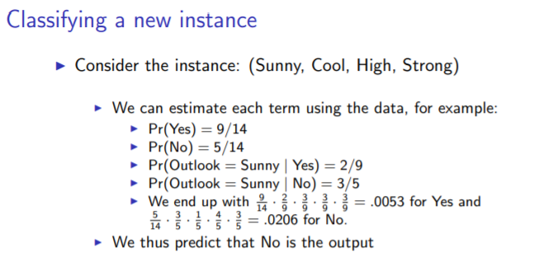
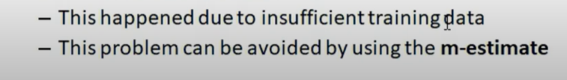
Approach to overcome zero frequency problem
If the posterior probability for one of the attributes is zero, then the overall class-conditional probability for the class vanishes.
This problem can be addressed by using the M-estimate approach.

Slide 16
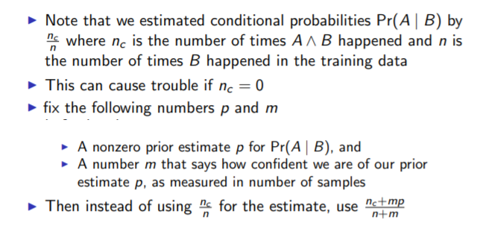
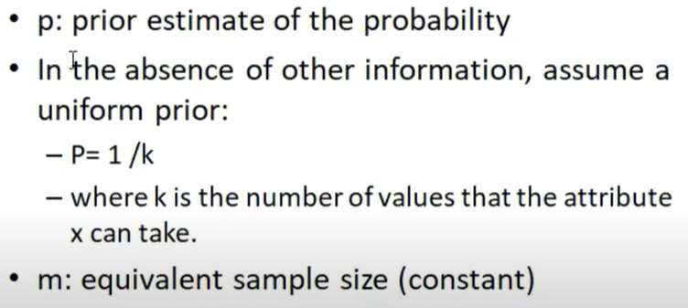
M-Estimate Approach

Slide 17
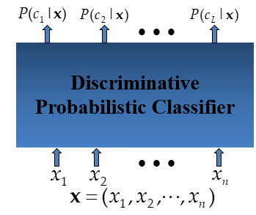
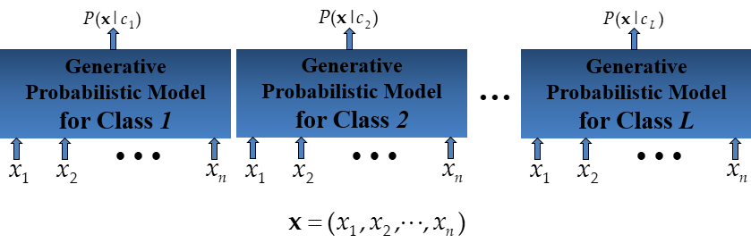
Generative Model
Generative classifier learn joint probability p(x,y) and use bayes’rule for computing P(y|x)
Discriminative models directly learn p(y|x) from data

Slide 18
Summary
Naive Bayes is a probabilistic supervised learning algorithm
Based on the independence assumption . Called “Naïve” because of this assumption
Uses prior knowledge with observed data
Training and testing is very easy and fast
Generative classifier model

Slide 19
Reference
Data Mining: Concepts and Techniques, (3rd Edn.), Jiawei Han, Micheline Kamber, Morgan Kaufmann, 2015.
Introduction to Data Mining, Pang-Ning Tan, Michael Steinbach, and Vipin Kumar, Addison-Wesley, 2014

Slide 20
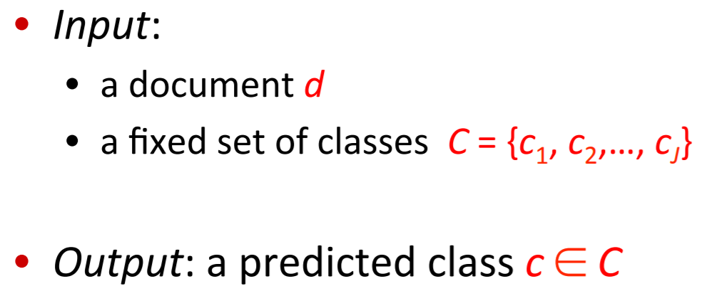
Text Classification using Naïve Bayes
Natural Language Processing (NLP) task
Applications include
Social media monitoring:
Customer feedback:
Market research:

Slide 21
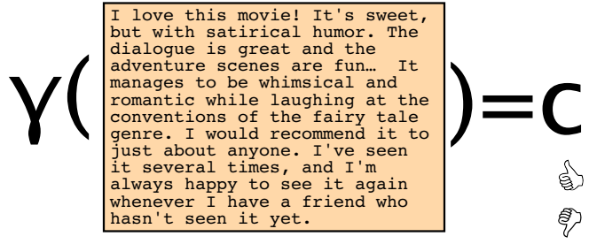
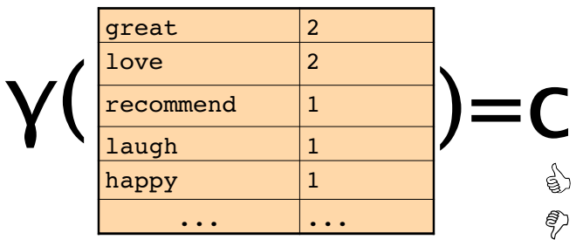
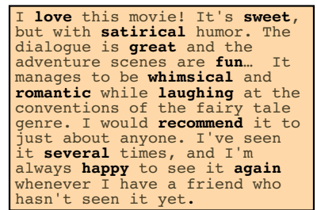
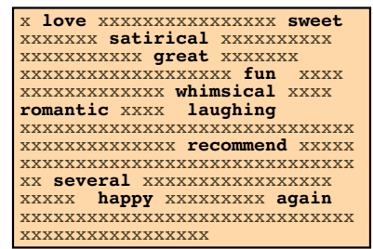
Bag of words representation
A bag-of-words model, is a way of extracting features from text to describe vocabulary of known words
To reduce vocabulary size, apply text cleaning techniques

Slide 22
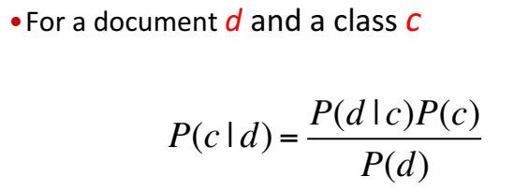
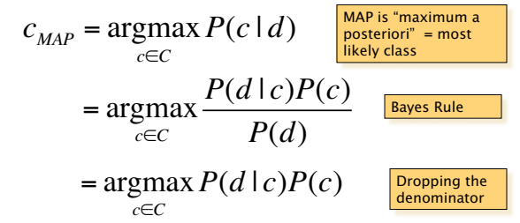

Naïve Bayes Classifier

Slide 23
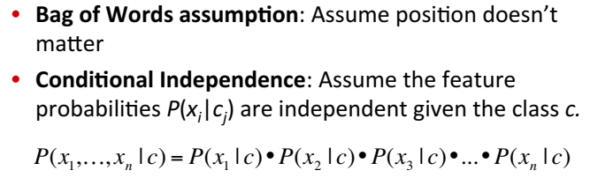
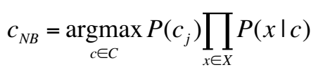
Assumptions

Slide 24
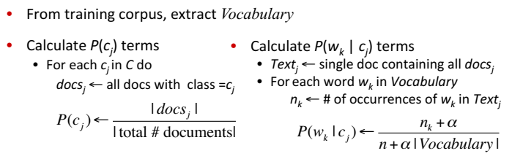
Naïve Bayes Learning

Slide 25
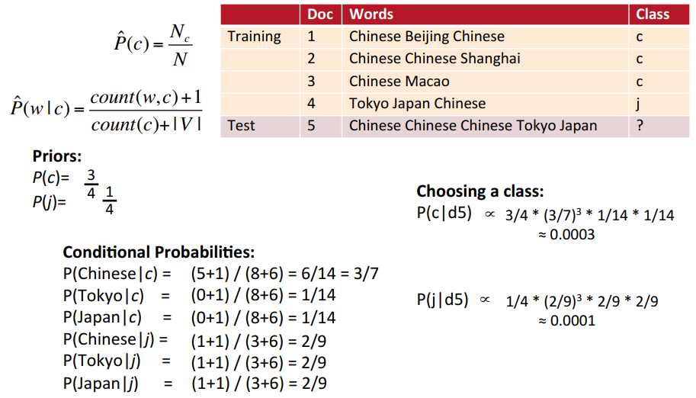

Slide 26
Summary
Uses Bag of Words representation
probability of the class of document is computed using Bayes theorem
Select a class with highest posterior probability

Slide 27
References
https://web.stanford.edu/class/cs124/lec/naivebayes.pdf
https://nlp.stanford.edu/IR-book/html/htmledition/naive-bayes-text-classification-1.html

